Slide 1
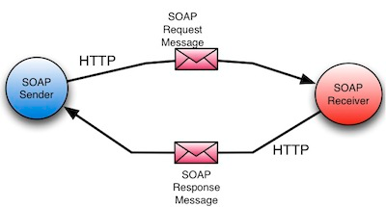
SOAP
Shikha Desai

Slide 2
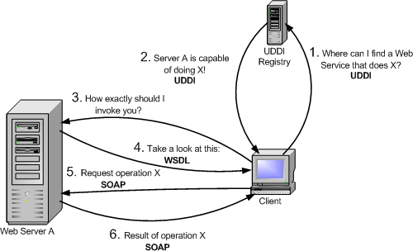
Introduction

Slide 3


UDDI (Universal Description, Discovery, and Integration)
  An XML-based registry for businesses worldwide to list themselves on the Internet.
  The project allows businesses to list themselves by name, product, location, or the Web services they offer.
WSDL (Web Services Definition Language)
  An XML format for describing network services as a set of endpoints operating on messages containing either document-oriented or procedure-oriented information.
  The operations and messages are described abstractly, and then bound to a concrete network protocol and message format to define an endpoint.

Slide 4
SOAP relies exclusively on XML to provide messaging services.
The XML used to make requests and receive responses in SOAP can become extremely complex.
In some programming languages, you need to build those requests manually, which becomes problematic because SOAP is intolerant of errors.
Some languages provide SOAP packages which handle the conversion of our normal message such as a Java method call to SOAP message.
SOAP can be used to exchange complete documents or to call a remote procedure.

Slide 5
Built-in error handling : If there’s a problem with your request, the response contains error information that you can use to fix the problem.
  The error reporting even provides standardized codes so that it’s possible to automate some error handling tasks in your code.
You don’t necessarily have to use it with the HyperText Transfer Protocol (HTTP) transport.
  It can be used with other transport layer protocols such as SMTP.

Slide 6
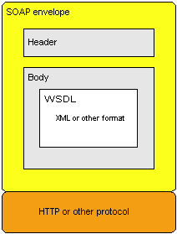
SOAP message

Slide 7
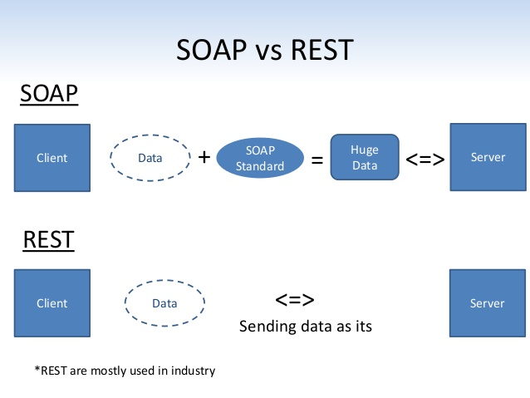
SOAP v/s REST

Slide 8
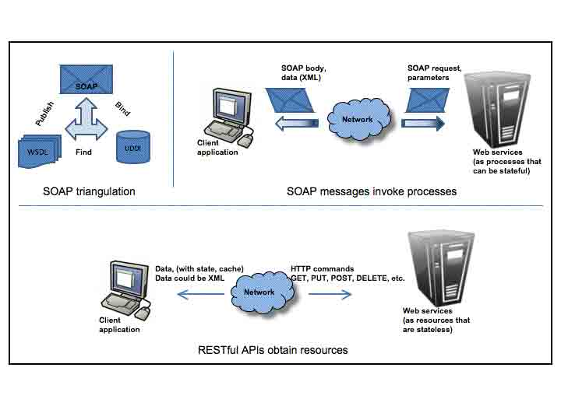
SOAP v/s REST

Slide 9
SOAP v/s REST
In many cases, the choice of Web service also determines your choice of protocol.
SOAP is definitely the heavyweight choice for Web service access. It provides the following advantages when compared to REST:
  Language, platform, and transport independent (REST requires use of HTTP)
  Works well in distributed enterprise environments (REST assumes direct point-to-point communication)
  Standardized
  Provides significant pre-build extensibility in the form of the WS* standards
  Built-in error handling
  Automation when used with certain language products

Slide 10
SOAP v/s REST
REST is easier to use for the most part and is more flexible. It has the following advantages when compared to SOAP:
  No expensive tools require to interact with the Web service
  Smaller learning curve
  Efficient (SOAP uses XML for all messages, REST can use smaller message formats)
  Fast (no extensive processing required)
  Closer to other Web technologies in design philosophy

